Slide 1

2D Arrays
Solution X
for (int i=0;i<10000;i++)
for(int j=0;j<10000;j++)
A[i][j]=1;
Solution Y
for (int j=0;j<10000;j++)
for(int i=0;i<10000;i++)
A[i][j]=1;
Cache friendly
Always evict
cache
Which one is better, X or Y?

Slide 2
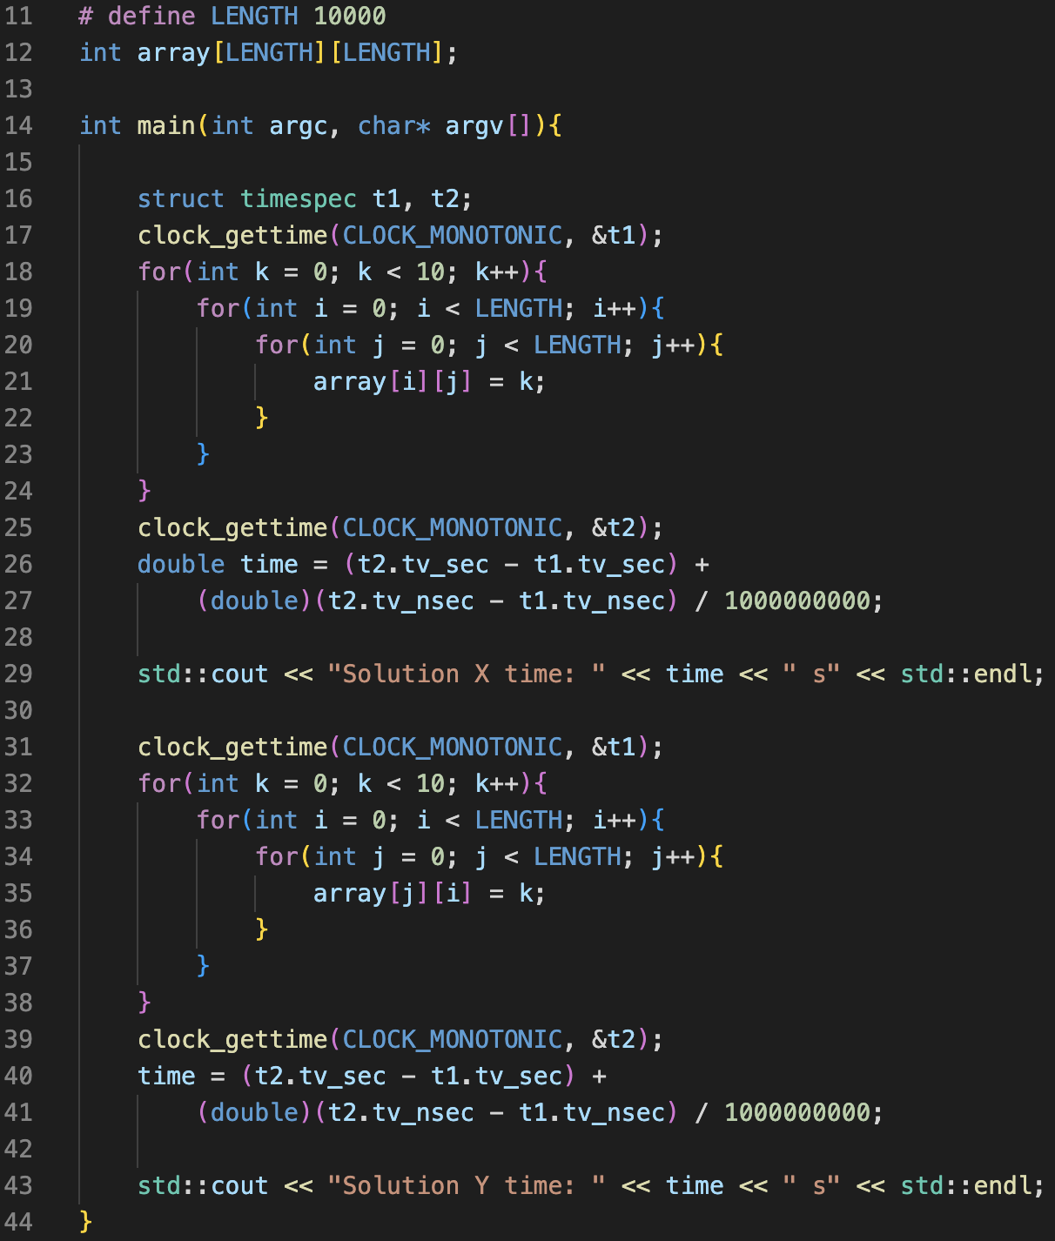
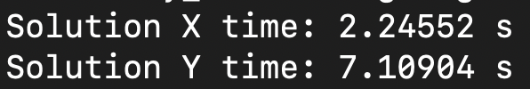
2D Arrays
Real-case code in C++
Execution result
Solution X
Solution Y

Slide 3
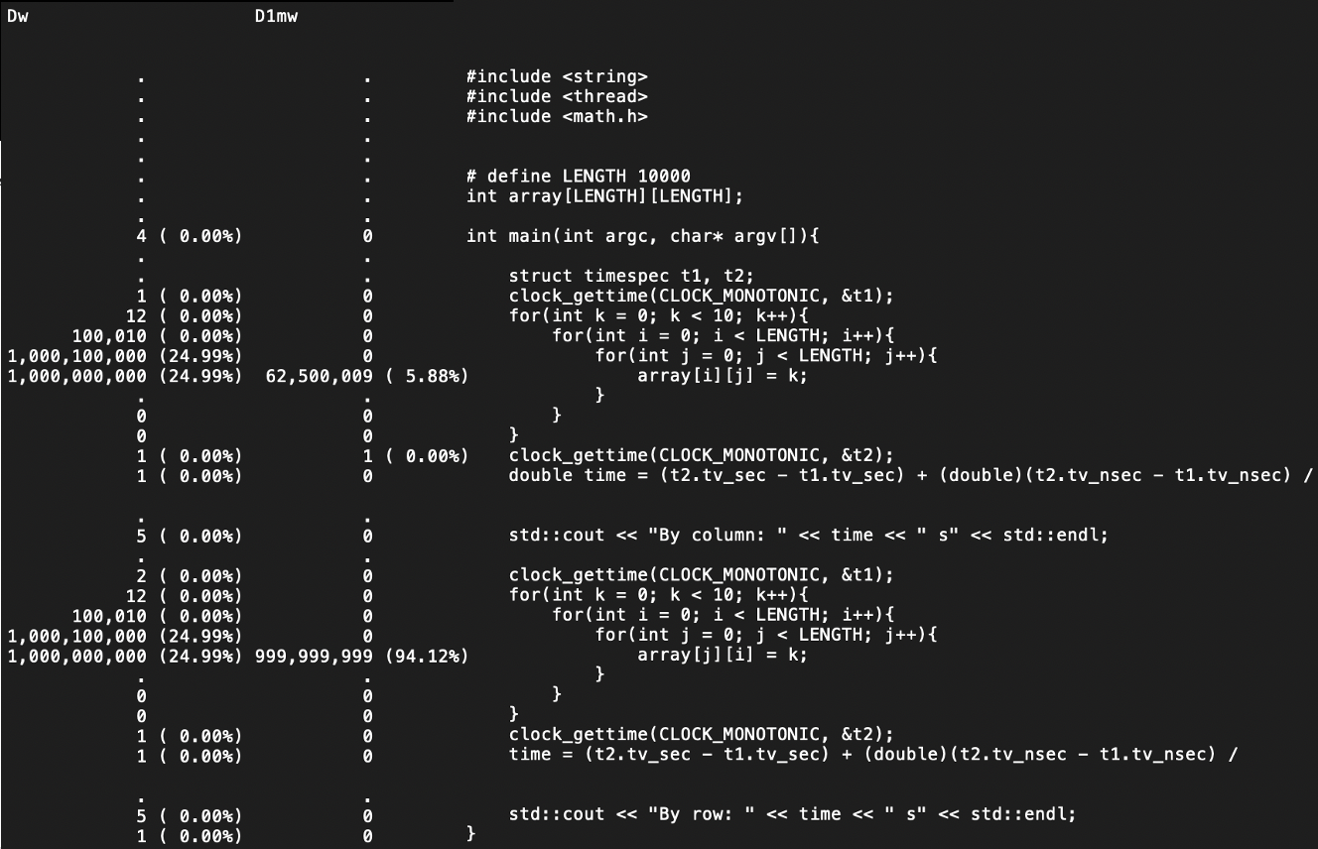
2D Arrays
Let’s profile this program with Valgrind:
How to interpret this?
Dw: D cache writes D1mw: D1 cache write misses
Cache line size: 64B
Method X:
Integer size: 4B
Which means a cache line can
contain 16 integers
1,000,000,000 / 62,500,000 = 16
Method Y:
Always evict cache
All cache writes miss
D1mw = Dw

